Slide 1
AI and Robotics

Slide 2
A Space Odyssey 2001 (1968)
https://www.youtube.com/watch?v=ARJ8cAGm6JE
Notes:
50 years ago a correct depict of AI

Slide 3
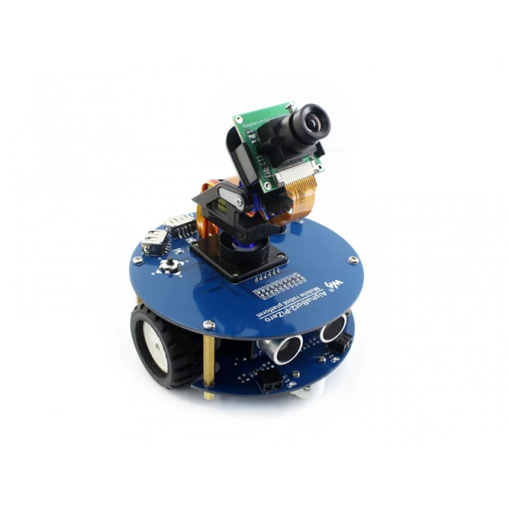
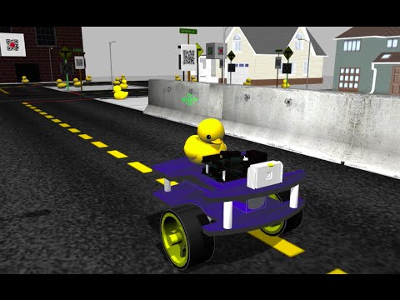
Today Objectives
Session 1: Hand craft rules – alpahbot2 - line following robots
Session 2: Deep learning – duckiebot - virtual environment
Notes:
game development
data science – assume you have some understanding of python
deep learning
robotics part 1
robotics part 2

Slide 4
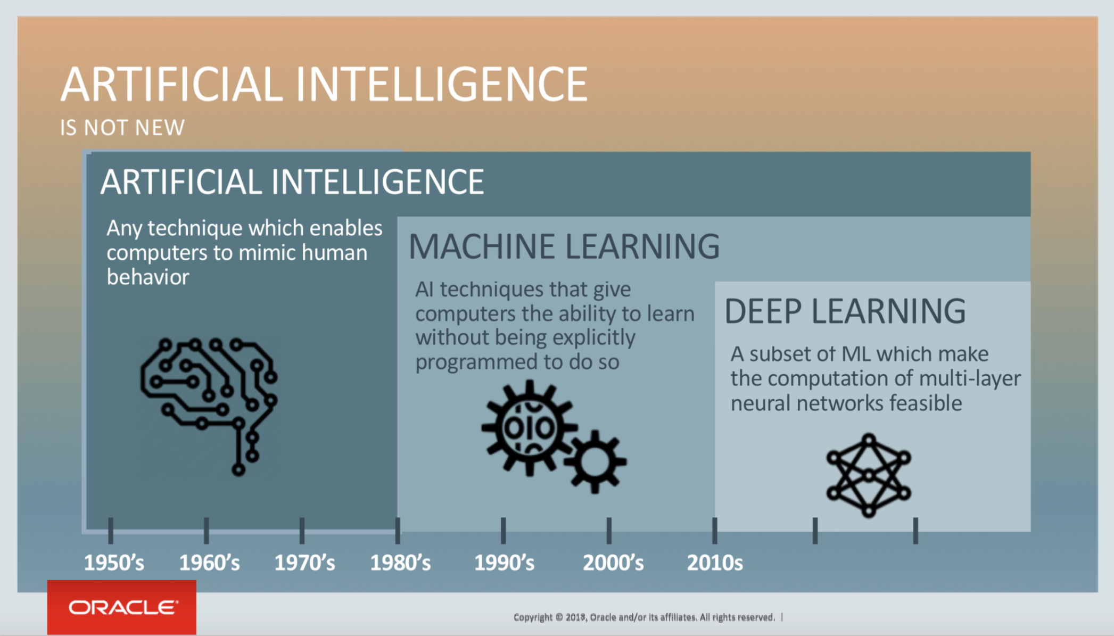
AI
Target
Method
one type of machine learning
Notes:
machine learning – let machine learn themselves
How we do AI before machine learning?
Biology – behavior of a creature depends on two things: 1. innate instinct 2. result of learning
We will discuss more on ML and DL in the second session

Slide 5
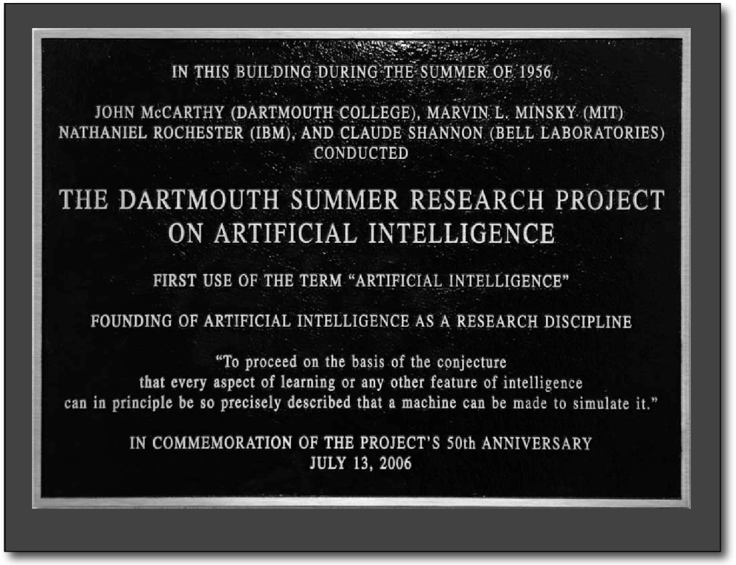
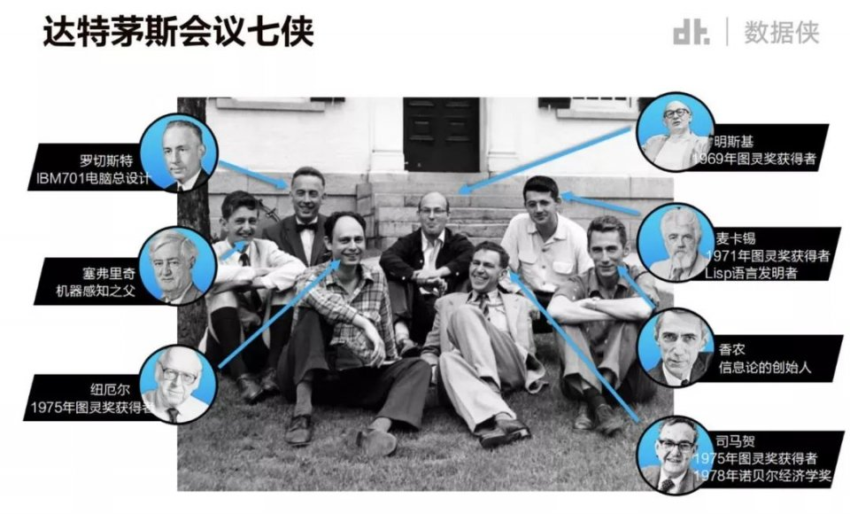
AI 1950’
The goal of AI is to develop machines that behave as though they were intelligent – John McCarthy
Photo from the 1956 Dartmouth Conference
Notes:
the term AI come from
Measurement of intelligent are diverse
captcha
turning test

Slide 6
AI 1950’
Hand Crafted Rules:
It mimic human understanding and knowledge
Hard to consider all possibilities
it will never surpass it’s creator
Lots of human efforts (not suitable for small industry)

Slide 7
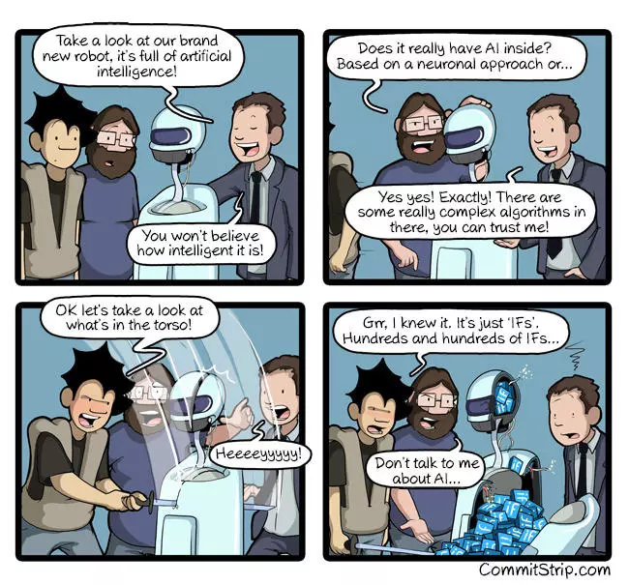
Notes:
the comic is not 100% correct because rule-based system is AI

Slide 8
Robotics
Robots interact with the physical world via sensors and actuators.
Robots are programmable.
Robots are usually autonomous or semi-autonomous.

Slide 9
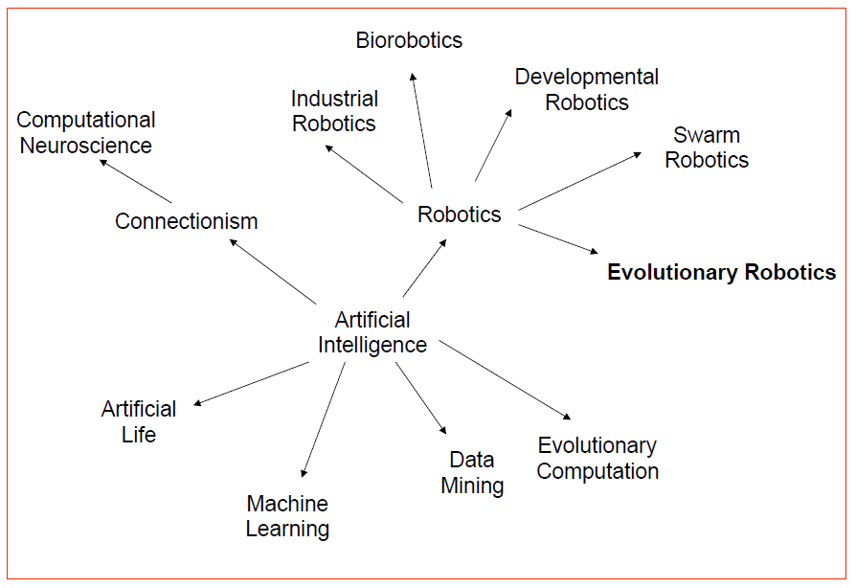
AI and Robotics
Notes:
At first they are separate subjects

